Slide 1

Strategic Risk Management and Risk Governance
Prepared and Presented by
Robert Stratton, JD, MBA
rob@robertbstratton.com
October 20^{th,} 2020

Slide 2
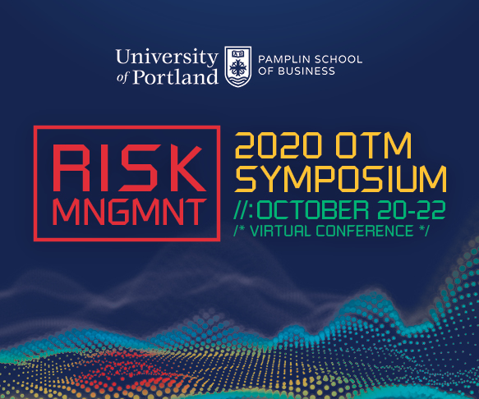
AGENDA
Who Am I?
Rob Stratton, Director Enterprise Risk Management Program and Internal Audit, Senior Counsel for Northwest Permanente P.C.
Designed and Implemented all new ERM program for NW Permanente
What Am I Going to Be Talking About?
What is Strategic Risk Management?
Why is Strategic Risk Management important?
Why should you care about it?
How do you implement Strategic Risk Management governance?
What Do I Want You to Takeaway From this Presentation?
Every Board and C-Suite must take Strategic Risk Management seriously
Applying Strategic Risk Management is easy

Slide 3
What is Strategic Risk Management?
You Probably Think About:
Insurance
Diversifying Supply Chains
Cyber Security
Regulatory Compliance
This is What I Think About:
Gambling
Negligent Homicide
Greed
Exploding Spaceships
The Limits of Consciousness

Slide 4
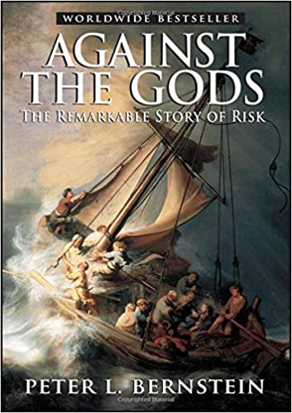

Gambling: Risk vs Opportunity

Slide 5
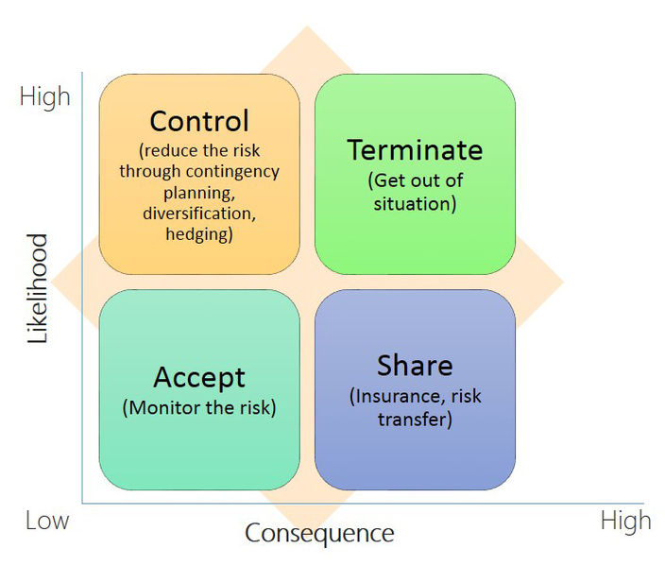
The Strategic risk Cycle
01
Risk Strategy: opportunity pursued
04
Strategic Risk Management Cycle
Strategic Planning: returns to opportunity seeking
02
Risk Event: mitigation strategy
developed
03
Risk Strategy operationalized
Title
Some text goes here. Some text goes here. Some text goes here. Some text goes here.

Slide 6


Negligent Homicide:
Governance Legal Standards
Caremark - Established Standard
(1) Have a system, (2) monitor it
“possibly the most difficult theory in corporation law upon which a plaintiff might hope to win a judgment.”
* This does not constitute legal advice. No attorney client relationship is established.
Notes:
Ensure board-level protocols are in place that require management to regularly report on key risks, steps taken to manage those risks, and any significant compliance deficiencies.
The board should employ a governance framework that regularly considers the company's risk management efforts and adequacy of the board-level protocols. The Board should not wait for the crisis to arrive for the discussion to begin.
Ensure the board-level protocols are documented and that the board discussion of risk management is contemporaneously and accurately documented in the board minutes.
Boards have flexibility to design a risk oversight system that is tailored to the company's business and resources.
¹⁰ Stone ex rel. AmSouth Bancorporation, 911 A.2d at 372 (quoting In re Caremark Int'l Inc. Deriv. Litig., 698 A.2d 959, 967 (Del.Ch.1996)).

Slide 7
Negligent Homicide
Marchand v. Barnhill (Blue Bell Creameries) changes things:
  BOD oversight of “mission critical” operations “must be more rigorously exercised.”
Caremark First Prong: monitoring systems should include:
  Both risk and compliance issues
  Regular and flexible reports to the Board apprising of compliance and risks
  Regularly scheduled board meetings to consider key risks
  Protocols for disclosing to the board adverse information received by management
  Framework/protocols documented
* This does not constitute legal advice. No attorney client relationship is established.
Notes:
Blue Bell had no board committee charged with monitoring food safety;
There was no schedule for the Blue Bell board to consider on a regular basis, such as quarterly of biannually, [whether] any key food safety risks existed;
The Blue Bell board had no regular process or protocols that required management to keep the board apprised of food safety compliance practices, risks, or reports;
Management received reports that contained what could be considered red, or at least yellow, flags, and the board minutes of the relevant period revealed no evidence that these were disclosed to the board;
The board was given certain favorable information about food safety by management, but was not given important reports that presented a much different picture; and
The board minutes were devoid of any suggestion that there was any regular discussion of food safety issues

Slide 8

Greed: In Re Clovis Oncology
1 drug in development | 0 products on market | $0 Revenue
Caremark Test Prong 2 in question: Did the Board monitor its risk systems?
“With hands on their ears to muffle the alarms…”
“red flags are only useful when they are either waived in one’s face or displayed so that they are visible to the careful observer….But, as Marchand makes clear, the careful observer is one whose gaze is fixed on the company’s mission critical regulatory issues.”
* This does not constitute legal advice. No attorney client relationship is established.
Notes:
upstart biopharmaceutical companies –
1 drug among its drugs under development, Rociletinib (or “Roci”), that was especially promising.
therapy for the treatment of lung cancer, performed well during the early stages of its clinical trial. But data from later stages of the trial revealed the drug likely would not be approved for market by the Food and Drug Administration (“FDA”).
BOD packed with experienced VC and scientists.

Slide 9
Greed: In Re Clovis Oncology
With hands on their ears to muffle the alarms….
In Re Clovis Oncology Lessons
  BOD must understand its Key Business Risks
  Key risks include mission critical regulatory issues
  BOD must be receptive to hearing risks
  BOD should act appropriately to reported risks
* This does not constitute legal advice. No attorney client relationship is established.
Notes:
A Board’s oversight of impactful business risks may be subject to greater scrutiny than the same Board’s oversight if less critical risks.

Slide 10
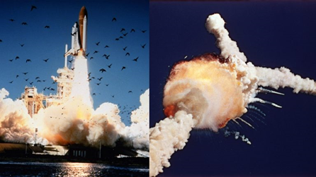

Exploding Spaceships: Risk Aware Culture
Notes:
No deaths during a space flight
No fatalities since training incident Apollo 1 in 1966
“An accident rooted in history“
O-Ring Flaw known since 1977
Concerns spoken the night before. Never escalated up the ladder.
“the lack of communication between the two camps,”

Slide 11
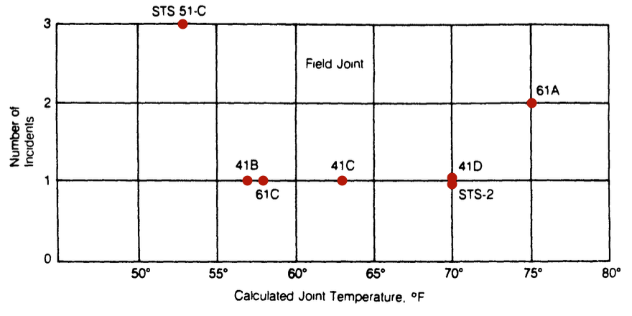
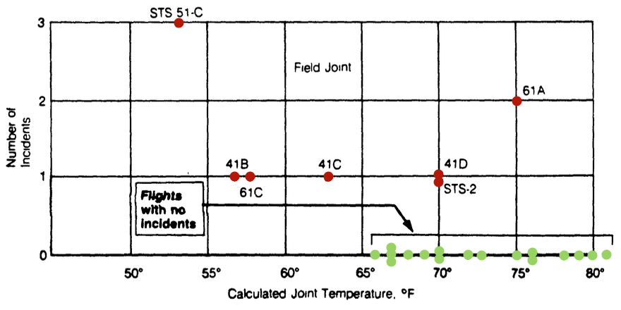
Culture: Effective Challenge
“Temperature data [is] not conclusive on predicting primary O-ring blowby.”
“A careful analysis of the flight history of O-ring performance would have revealed the correlation of O-ring damage in low temperature”
Notes:
Temperate affecting flights was discussed the night before the disaster.
The graph helped engineers determine temperate wasn’t a causal factor of o ring incidents.
the flights with zero incidents were excluded from the plot because it was felt that these flights did not contribute any information about the temperature effect.
The Rogers Commission graphed with flights that had no incidents and found a clear correlation.

Slide 12
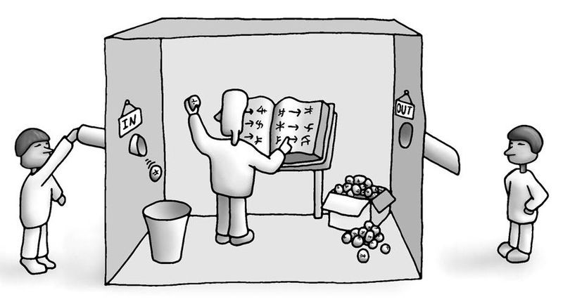
The limits of Consciousness: The Chinese Room
Notes:
without "understanding" (or "intentionality"), we cannot describe what the machine is doing as "thinking" and, since it does not think

Slide 13
Behavioral Economics
Cognitive Biases - people act predictably irrational
Bounded Rationality - seeking a satisfactory solution rather than an optimal one
“Intellectual Hazard, as we define it, is the tendency of behavioral biases to interfere with accurate thought and analysis within complex organizations. Intellectual hazard impairs the acquisition, analysis, communication and implementation of information within an organization and the communication of such information between an organization and external parties.”
Notes:
Moral hazard is typically the cognitive bias used in risk management. “lack of incentive to guard against risk where one is protected from its consequences, e.g. by insurance.” But in large complex organizational filled with a lot of smart people, there’s another bias that is more dangerous.
Bounded rationality is the idea that when individuals make decisions, their rationality is limited by the tractability of the decision problem, their cognitive limitations and the time available. Decision-makers in this view act as satisfiers, seeking a satisfactory solution rather than an optimal one. When risk owners can’t mitigate risks, its up to BOD oversight to refocus satisfactory solution vs optimal.
Examples:
Smart Educated people more susceptible to bias

Slide 14
Lessons
Strategy and Policy makers must:
  Understand the Risk/Opportunities concept
  Focus on dialogue over rules
  Resist demoting risk management to purely an operational tactic
  Use language and other tools to create a risk aware culture

Slide 15
Implementation
Northwest Permanente P.C. – Unique like everyone else
  For-Profit Private Corporation
  B-Corp
  Integral part of Kaiser Permanente
  Extremely Complex
Disclaimer: The following information on enterprise risk program implementation is for informational purposes only. These examples are highlights of program considerations, which are in draft form. They do not represent a comprehensive risk program. All thoughts and opinions expressed are those of Robert Stratton, JD, MBA, and not of Northwest Permanente P.C.

Slide 16
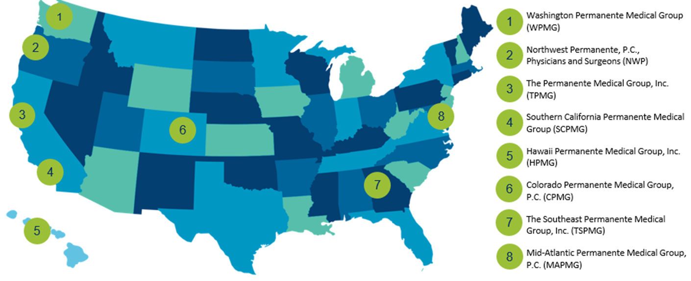
Permanente Medical Groups
Notes:
Permanente Medicine is the unique approach that physicians and clinicians of the eight self-governed, self-managed Permanente Medical Groups use to care for the patients and members of Kaiser Permanente.
The quality and excellence of Permanente Medicine is the result of a culture of physician leadership that drives research and innovation to create value for our patients and our communities.
In Oregon, Northwest Permanente cares for more than 626,000 Kaiser Permanente members in Oregon and Southwest Washington

Slide 17
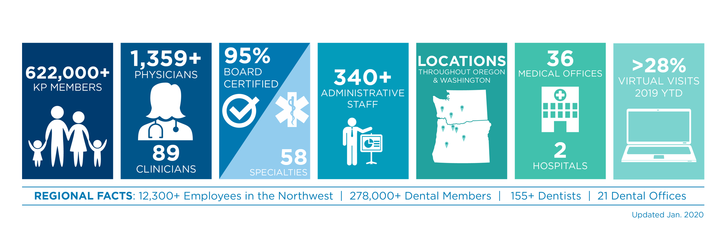
Northwest Permanente Fast Facts

Slide 18

Kaiser Permanente: The nation’s largest integrated value-based health care system.
Notes:
The three-pronged care model we use at Kaiser Permanente Northwest is the same model used by Kaiser Permanente locations all across the country.
One big differentiator with Kaiser Permanente is that physicians and clinicians make the decision about the care their patients receive – not an insurance plan.
Permanente Medicine is integral to the success of Kaiser Permanente.

Slide 19
Common Language
Key Enterprise Risk – Otherwise known as a top tier risk. These risks are the most consequential and significant to shareholder value. Risks that rise to the level of BOD visibility.
Risk Owner – A member of senior management that is responsible for the development, implementation, and reporting of key risk management action plan.
Captive Risk – A process in which the BOD works with the key risk owner to gather information and set medium term strategy and vision for the key risk management action plan.
Delegated Risk – A key risk that is delegated wholly to the risk owner once BOD approves a risk appetite and risk tolerances relevant to the key risk.
Notes:
DefDefine asdfasdfasdfasdfasdfasdfasdfasdfasdfasdfasdfasd

Slide 20
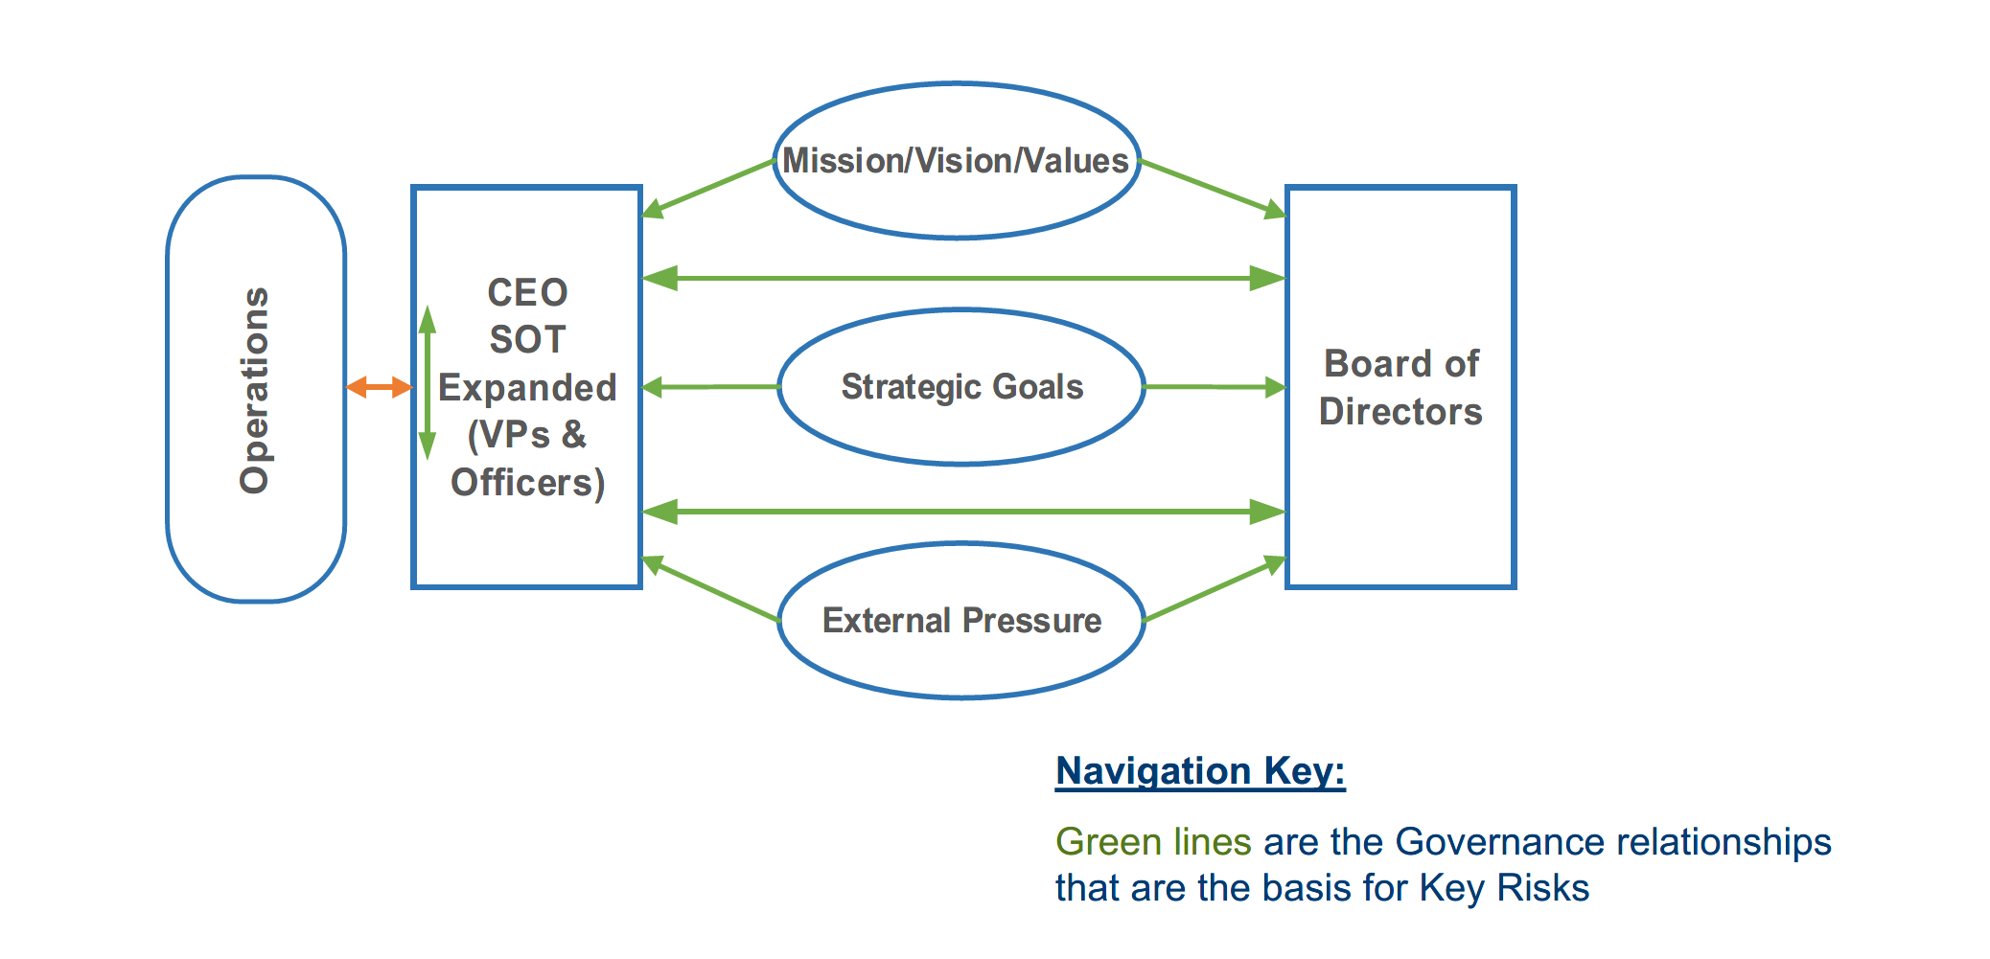
Common Language

Slide 21
Common Framework
Standards of Materiality:
  Risk
  “What is material to the ERM&A Committee are circumstances or pending decisions that have or could have an adverse effect on Northwest Permanente accomplishing…”
  Governance/Strategic
  “What is material to the Northwest Permanente Board of Directors are circumstances…”

Slide 22
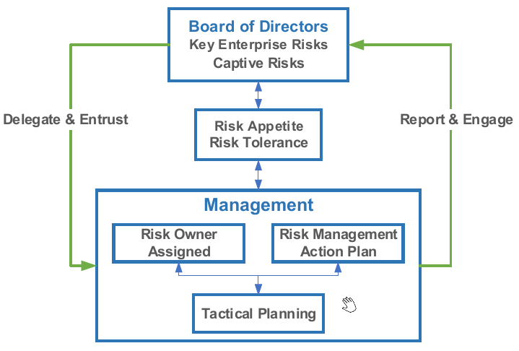
Common Framework

Slide 23
Key Enterprise Risks:
Opened dialogue between BOD, Senior Management, and other stakeholders.
Identified Mission Critical Key Enterprise Strategic Risks
Defined the risks
Memorialized organization approach to the risk through risk appetite
Delineated strategic vs operational approach to mitigation

Slide 24
Purposeful Language
Definition
  Formal language
  Connects to strategic objectives
  Indicates how its material to key enterprise risks
Risk Appetite
  First person – “We”
  Sets tone – inclusive – We are all responsible
  General guidance – qualitative
  Reasonable minds might disagree on specifics
Risk Tolerances
  Agreement between management and Board on operational oversight triggers
  Uses the shorthand language of the company
Notes
  Non-binding – current state
  Gives context to rest of risk statement

Slide 25
Transparency
“Democracies die behind closed doors.”
-Judge Damon Keith, U.S. Court of Appeals Sixth Circuit

